Slide 1
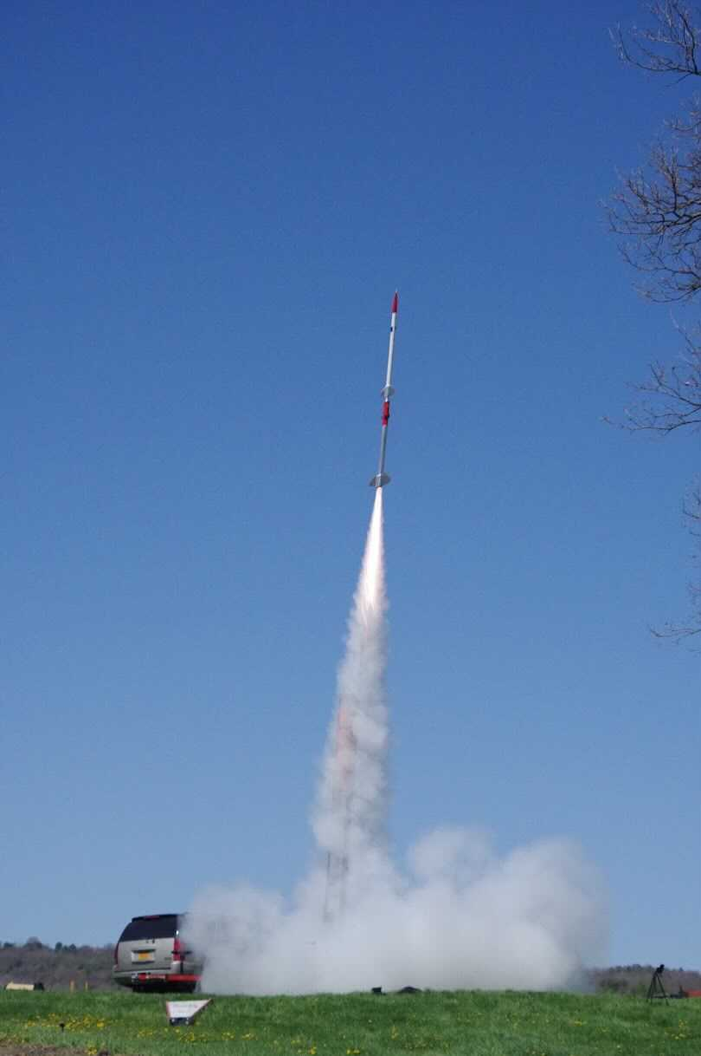
Discovering Rocketry
With MIT Rocket Team
Notes:
Start with Introduction, then explain photo
Add Videos (in Pad Cameras)

Slide 2
Overview
Intro to Rockets
How A Rocket Works
Physics
Stability
Recovery
How to Build Your Own Rocket
Resources

Slide 3
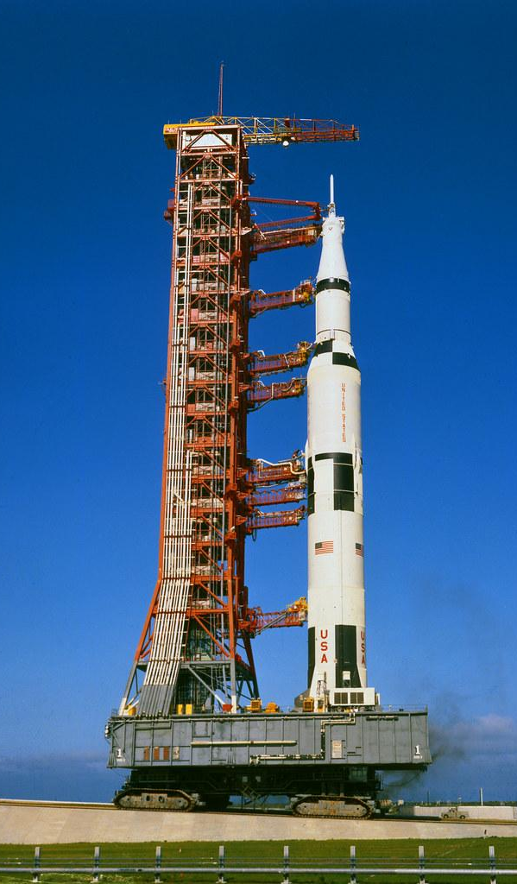
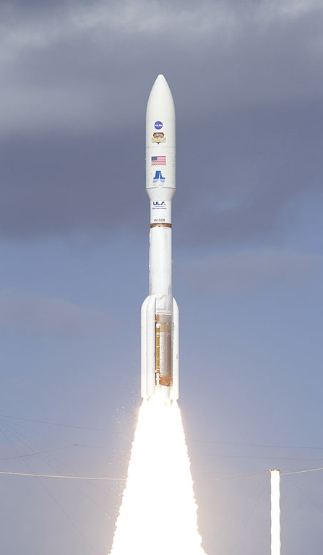
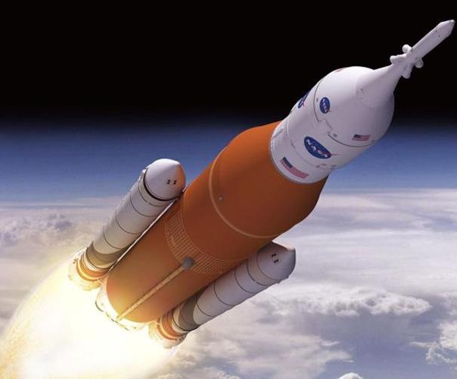
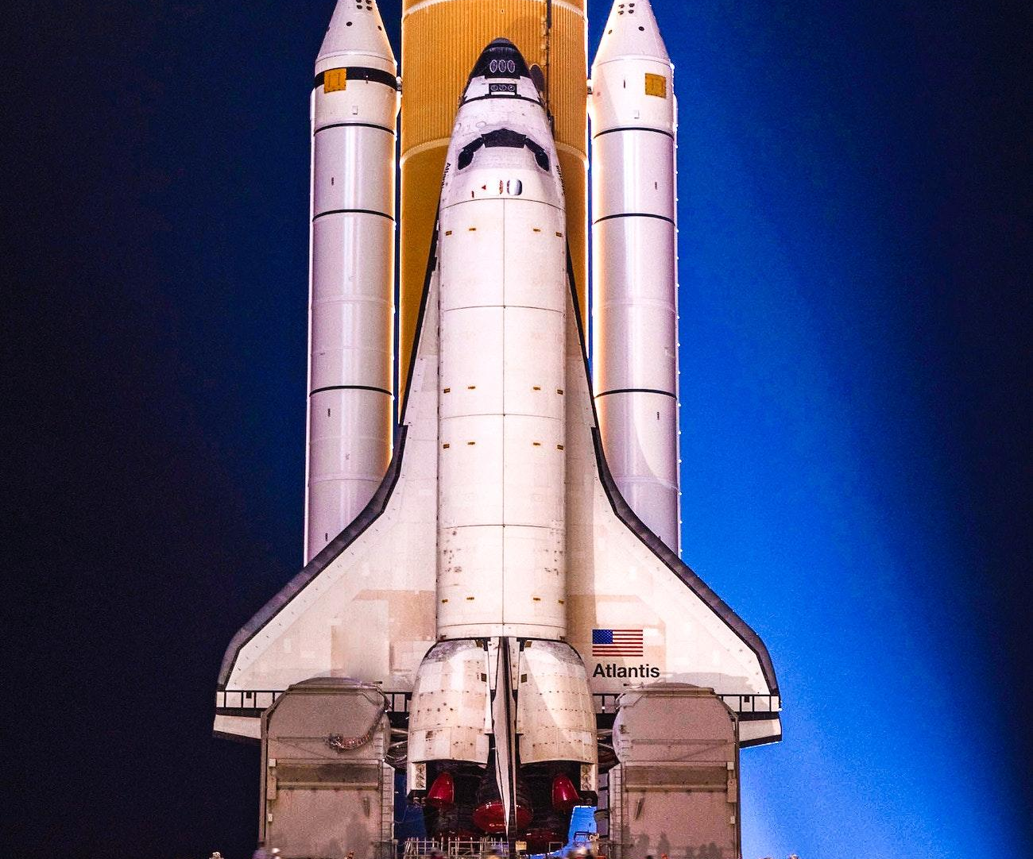
Notes:
Explain these are large industrial rockets (what first pops up when we think “rocket”), Maybe play game of name that rocket/give quick overview of each

Slide 4
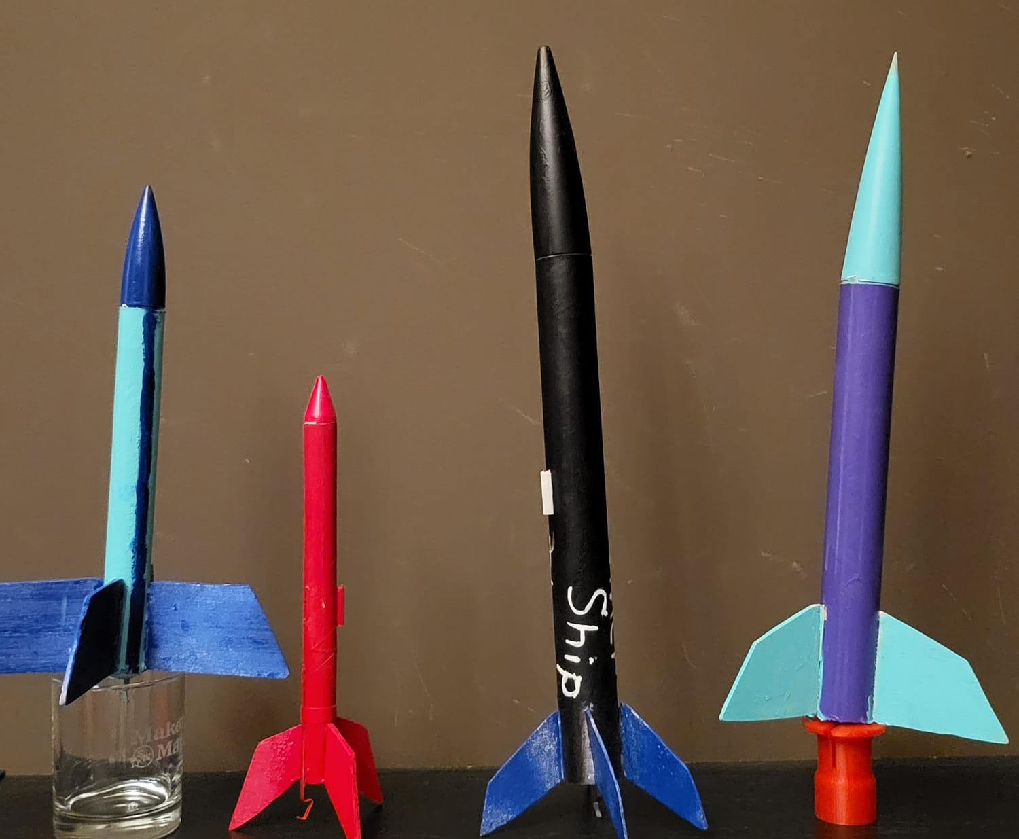
Notes:
Amateur Rocketry: Highlight that there are many levels that require different certification, emphasize that these and previous all share common physics; Note these will be our main focus today

Slide 5
Physics
Newton’s Third Law
Conservation of Momentum
Rocket Equation

Slide 6
Newton’s Third Law and Conservation of Momentum
Newton’s Third Law
-“The interaction forces between two objects are equal and in opposite directions.”
– Isaac Newton, 1687
-For rockets, one object is the rocket, and the other object is the exhaust gases (fuel).

Slide 7
Newton’s Third Law and Conservation of Momentum
Conservation of Momentum
p=mv
p=momentum
m=mass
v=velocity
Momentum is a conserved quantity: this means it does not change in a system with no external forces

Slide 8
Combine Concepts
Third Law
As the rocket pushes fuel out, the exhaust gasses push the rocket back up
Conservation of Momentum
When fuel is ejected, the mass of the system decreases. In order for p to remain the same, v must increase
Conclusion: The ejecting of fuel pushes the rocket up and increases its speed

Slide 9
Rocket Equation
As we use more propellant,
thrust is constant, the rocket gets lighter, so acceleration increases!
**Insert Fancy Math Here**
Conclusion: Go faster or carry heavier payload by increasing v_{exhaust} and decreasing m_{rocket} while simultaneously ejecting as much mass as possible

Slide 10
Stability
Definition
Center of Gravity
Center of Pressure
Rotation

Slide 11
What is Stability?
For something to be stable, it must return to its original position if disturbed
Stable
Unstable
Notes:
Discuss the marble in a bowl example and explain why one is stable and the other isn’t

Slide 12
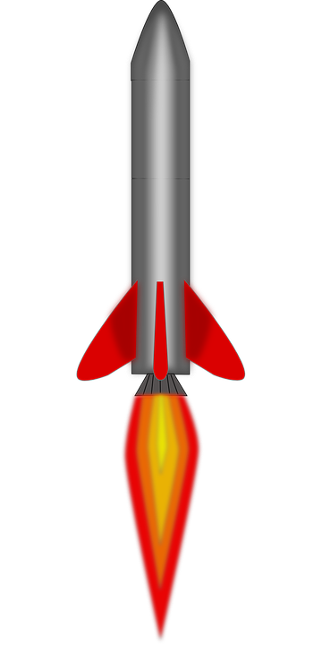
Center of Gravity and Pressure
Center of Gravity (or center of mass) is the average location of all of an object’s mass
An object will rotate around this point if a force is applied anywhere else
If a force is applied at this point, the object will not rotate
We can assume the weight (downward force) of an object acts at this point
Center of Pressure is where all the aerodynamic forces act on an object
CG
CP

Slide 13
What happens if Our Rocket Rotates
CG
CP
CP
Weight
CG
Drag
Drag
Weight
Notes:
Talk through what happens with each example, conclude that left rocket is ideal

Slide 14
What happens if Our Rocket Rotates
CP
CG
Weight
Drag
CG
Drag
CP
Weight
Notes:
Again, talk through what happens in each case, Conclude that right option is stable. If a rocket was designed the wrong way, it would tumble through flight

Slide 15
Conclusion
We want the center of pressure to be below the center of gravity to have a stable rocket
We achieve this by making the fins have a larger area (moves center of pressure down)
Or by adding weight to the front of the rocket (moves center of gravity up)
CG
CP
Notes:
Again, talk through what happens in each case, Conclude that right option is stable

Slide 16
Recovery
Forces
Terminal Velocity
Designing Parachute

Slide 17
Forces
Weight (gravity) pulls the system down
Weight=F_{g}=mg (mass times gravity)
Drag (D) Pulls the system up
D = .5 ρ C_{D} A V²
ρ = density of air
C_{D} = drag coefficient
A = projected area of parachute
V = descent velocity
DRAG
Weight

Slide 18
Terminal Velocity
As the system falls down, it accelerates. This increases the V in the drag equation
The velocity can not get too big however, because if the drag is greater than the weight, the system would “fall” upward (Obviously this does not happen)
This means the fastest the system can fall is when drag=weight
The value of V at this point is called terminal velocity
Drag=.5 ρ C_{D} A V²
Weight=mg

Slide 19
Designing Parachute
.5 ρ C_{D} A V²=mg
In this equation there are some things that can not change
mg
ρ
C_{D}
Our goal is to lower V in order to recover our rocket safely
If every other term stays the same, the way to do this is to increase the area, A
Drag=.5 ρ C_{D} A V²
Weight=mg

Slide 20
How to Make Your Own Rocket

Slide 21
Parts You Will Need
Nose Cone
Parachute
Body Tube
Motor Mount
Fins
Some other things: Recovery Wadding/parachute Blanket, Shock Cord, Launch Lug, Motor, igniter, launchpad+launch controller
Notes:
Quickly go explain each part
Everything can be found at a local hobby shop or on the internet

Slide 22
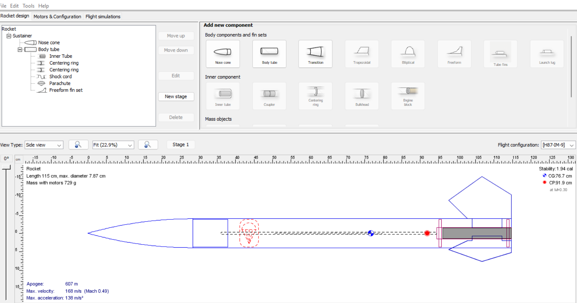
Designing Your Rocket
OpenRocket Software
Free Download
Calculates CP and CG
Simulates Rocket Flights
Note On Stability: aim for caliber between 1-2
caliber is a measure of the number of body tube diameters between the CG and CP
Notes:
You add parts by clicking the corresponding option in the menu
You can design fins by choosing freeform and making a shape yourself

Slide 23
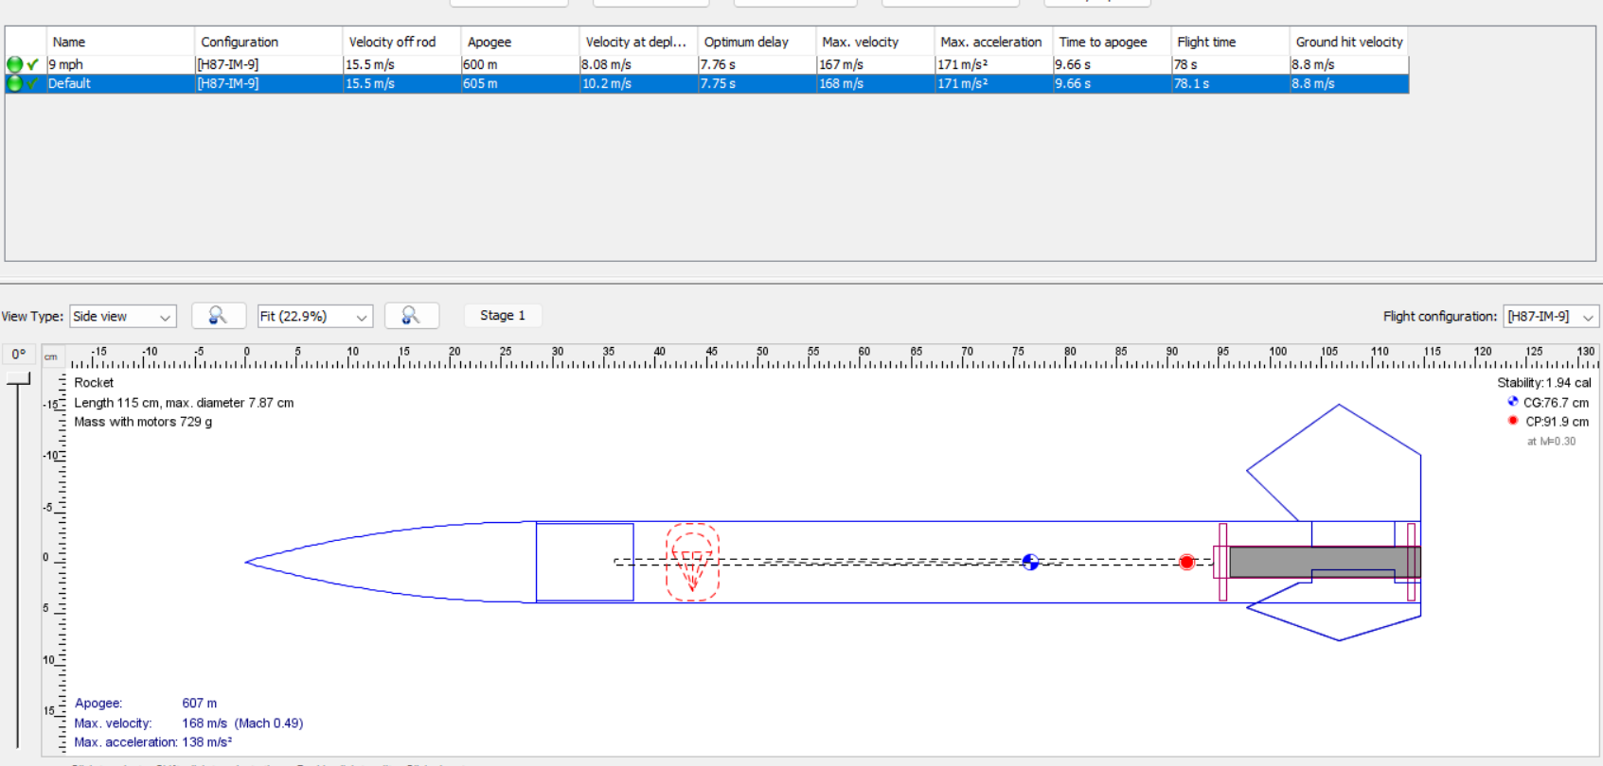

Slide 24
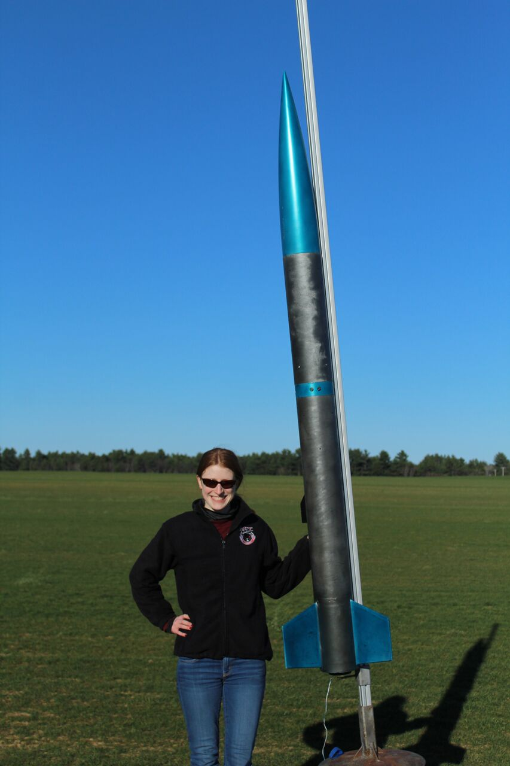
Launching Large Rockets
National Association of Rocketry/ Tripoli Rocketry Association
Find a local club
Get L1 Certification
Higher Certification means you can buy bigger motors!! :)
Great advice for rocket building online

Slide 25
Resources
National Association of Rocketry
nar.org
Tripoli Rocketry Association
tripoli.org
Make: Rockets by Mike Westerfield
great guide book on building model rockets
OpenRocket Software
openrocket.info
MIT Rocket Team
rocketry.mit.edu

